Slide 1

BY THE POWER OF ANALYTICS ENGINEERING!

Slide 2




Johnny winter (HE/HIM)
Notes:
I’m Johnny Winter – my pronouns are he him.
For those that don’t know me…
I work as a consultant for Advancing Analytics – we’re Data Engineering, Analytics and AI specialists
In my spare time I run the website Greyskull Analytics where I have a blog and YouTube channel, mainly covering content on Power BI
And I’m also one of the co-organisers of the Manchester Power BI user group, one of the biggest and longest running user groups in the UK

Slide 3






Notes:
I’ve been working in data since 2007 and here are some of the places that career has taken me.
My last 3 roles have all been consultancy jobs

Slide 4













Thank you to our Fabric February Friends!

Slide 5
fabfeb.app

Slide 6



Share your feedback in any language using voice or text!
fabricfebruary.com/feedback

Slide 7

agenda
What is Analytics Engineering?
How can I apply Analytics Engineering to Fabric and Power BI?
Notes:
And I’m here today to cover toe following topics…
What is Analytics Engineering and how can it be applied in Fabric?

Slide 8
What is analytics engineering?

Slide 9
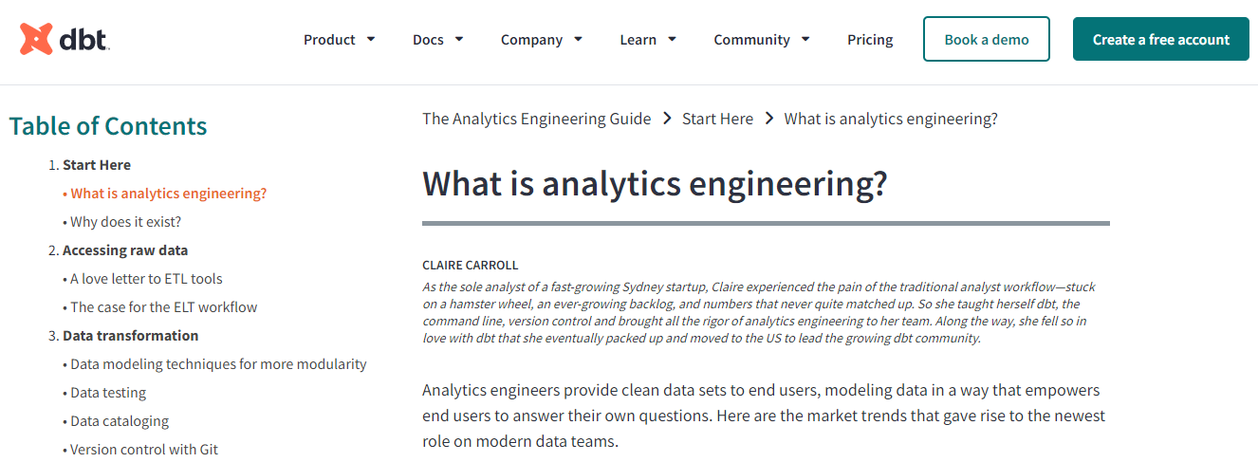
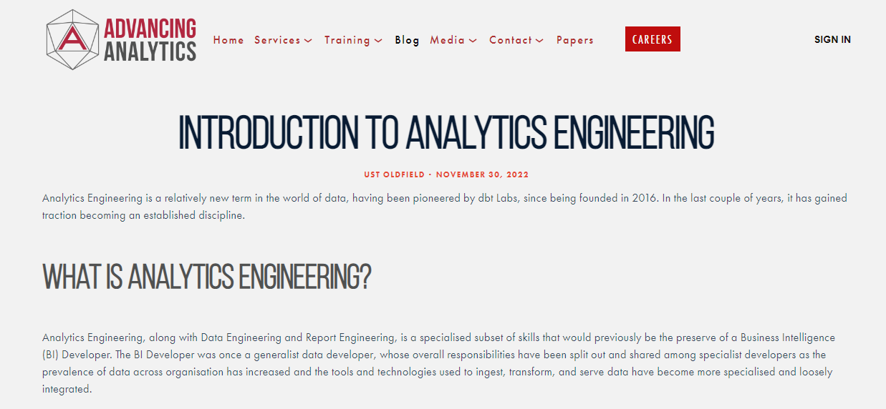
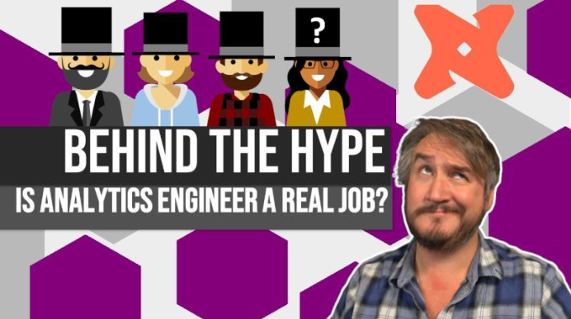

Slide 10



Business intelligence
SSIS
SSAS
SQL SERVER
SOURCES
EXCEL
Notes:
I prefer to describe is using my own career as a bot of a history lesson.
Going back 7-8 years, I was a Businss Intellgence Developer.
These were the technologies I worked with back then, all on prem.

Slide 11

Notes:
And this is what development was like.
A bit wild west, a bit cowboy.
We didn’t have test environments, we didn’t use source control – we’d often make changes directly on live.

Slide 12










Technology changes
Data Factory
Pipelines
RAW
BASE
CURATED
Files
Tables
Tables
Tables
Data Factory
Copy
DELTA
DELTA
Direct Lake
DELTA
PowerBI
SOURCES
Notes:
Fast forward, and the technology landscape has changed…
This is a reference architecture using Fabric. But this could just as easily be any Lakehouse reference architecture

Slide 13

WORKING PRACTICE CHANGES
Code first based approaches (Spark, Scala, Python)
Infrastructure as Code (Terraform, Bicep)
Better source control practices
Continuous Integration / Continuous Deployment (CI/CD)
Testing
Automation
Notes:
With changes in technology, we’re also seen working practices evolve, borrowing practices from software engineering.

Slide 14
RISE OF THE DATA ENGINEER
DATA ENGINEERING
Data Factory
Pipelines
RAW
BASE
CURATED
Files
Tables
Tables
Tables
Data Factory
Copy
DELTA
DELTA
Direct Lake
DELTA
PowerBI
SOURCES
Notes:
And we’ve seem the rise of the data engineer.
The data engineer role is mainly responsible for the left side if this architecture. Data onboarding, pipelines, data quality and cleansing for example.
But the right hand side of this has perhaps been a little left behind.
Perhaps that’s due to the emphasis on self service and the rise of the citizen data engineer?
Perhaps a lack of tooling has contributed?
It’s only since the release of Fabric that we’ve really even seen source control for Power BI.

Slide 15
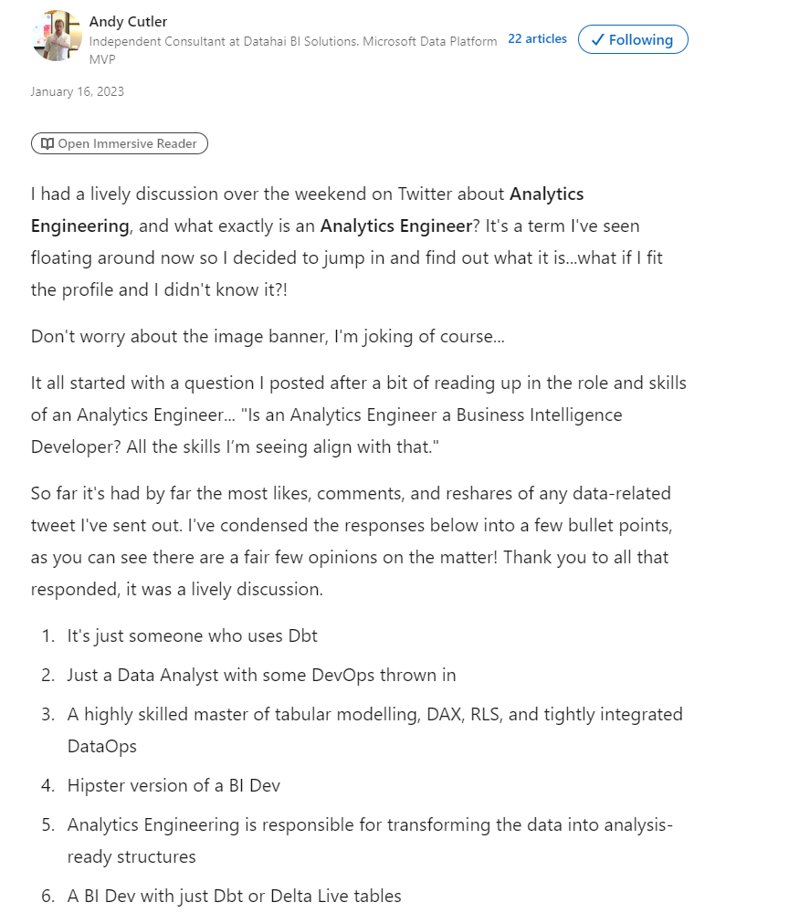

EMERGENCE OF ANALYTICS ENGINEERING
Notes:
Until now… because Analytics Engineering is seeking to redress that balance and start applying these more robust practices to the analytics side of that architecture diagram

Slide 16

“They’ve re-badged it, you fool!”

Slide 17




BI DEVELOPER
ANALYTICS ENGINEER

Slide 18


Slide 19
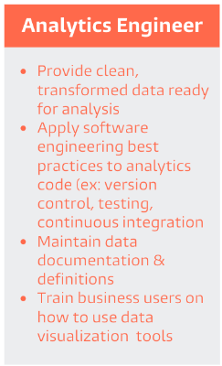

Slide 20
RISE OF THE ANALYTICS ENGINEER
ANALYTICS ENGINEERING
CURATED
Tables
DELTA
Direct Lake
PowerBI

Slide 21

BRIDGING THE GAP
Notes:
An Analytic Engineers is also seen as a role that can bridge the gap between business users and data engineers. They approach problems with more of a business hat on.

Slide 22
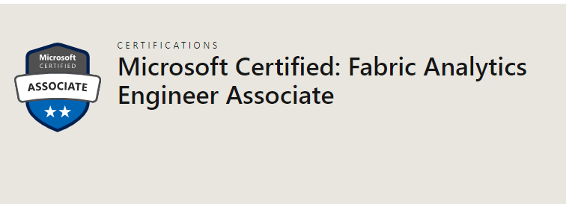
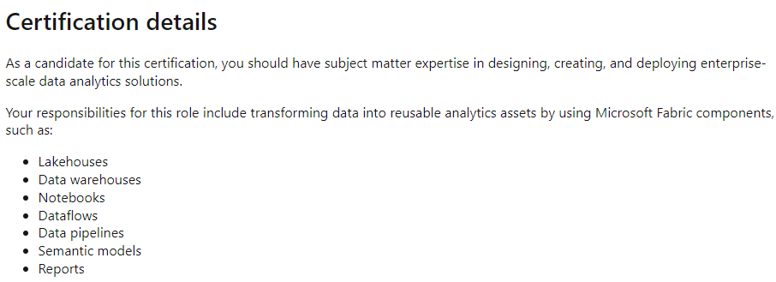
JUST TO CONFUSE YOU…

Slide 23
The Data OPS MANIFESTO
https://dataopsmanifesto.org/en/
9. Analytics is code:
Analytic teams use a variety of individual tools to access, integrate, model, and visualize data. Fundamentally, each of these tools generates code and configuration which describes the actions taken upon data to deliver insight.
11. Make it reproducible:
Reproducible results are required and therefore we version everything: data, low-level hardware and software configurations, and the code and configuration specific to each tool in the toolchain.
15. Quality is paramount:
Analytic pipelines should be built with a foundation capable of automated detection of abnormalities (jidoka) and security issues in code, configuration, and data, and should provide continuous feedback to operators for error avoidance (poka yoke).
17. Reuse:
We believe a foundational aspect of analytic insight manufacturing efficiency is to avoid the repetition of previous work by the individual or team.
18. Improve cycle times:
We should strive to minimize the time and effort to turn a customer need into an analytic idea, create it in development, release it as a repeatable production process, and finally refactor and reuse that product.

Slide 24
analytics engineering IN FABRIC

Slide 25


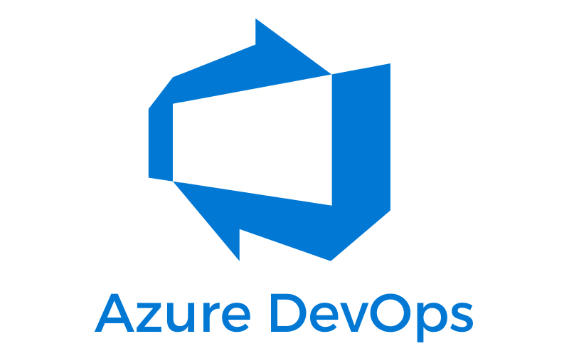
TOOLS FOR ANALYTICS ENGINEERS

Slide 26
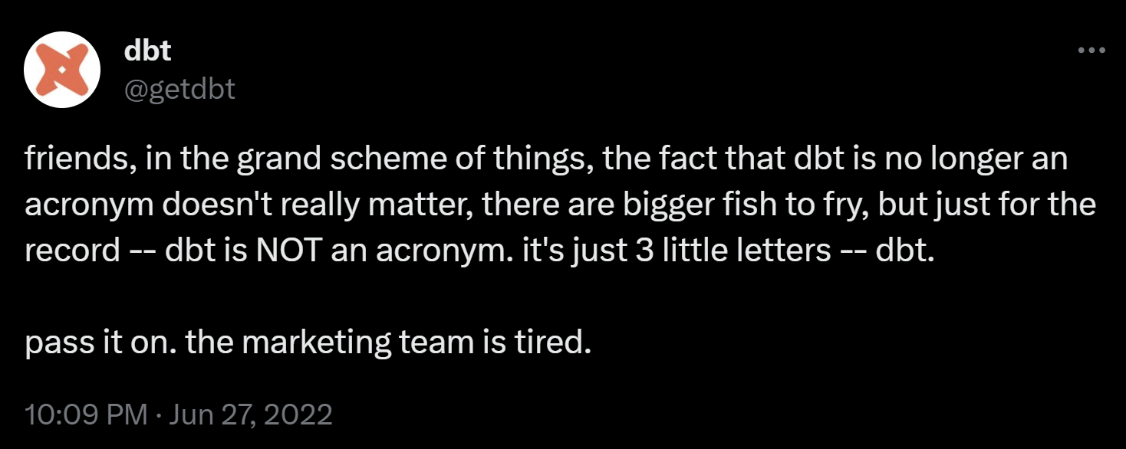
dbt
Originally data build tool
SQL-first transformation workflow – the “T” in ETL
Available as dbt-core or dbt-cloud
Fabric connectors announced for Data Warehouse

Slide 27

TO THE DEMO LAIR!

Slide 28
TABULAR EDITOR
Used for building Semantic Models
Fabric and DirectLake compatible
Open source and licensed options available.

Slide 29

TO THE DEMO LAIR!

Slide 30
AZURE DEV OPS
Can be used as a Git repository
Pipelines

Slide 31

TO THE DEMO LAIR!

Slide 32
 | Version Control | Testing | Continuous Integration | Documentation | Automation
dbt | Git repository | dbt Tests | Using Azure Dev Ops Pipelines | Generates own documentation | Macros
Tabular Editor | Git repository | Best Practice Analyzer | Using Azure Dev Ops Pipelines | Can use metadata to build documentation | C# Scripts

Slide 33
QUESTIONS?

Slide 34
THANK YOU!
Twitter:
@GreyskullPBI
LinkedIn: https://www.linkedin.com/in/j0hnnyw1nter/
Websites:
https://greyskullanalytics.com/
https://www.advancinganalytics.co.uk/

Slide 35
fabfeb.app

Slide 36
Share your feedback in any language using voice or text!
fabricfebruary.com/feedback

